Slide 1
CSS

Slide 2
Contents
Selectors
Positing Schemes

Slide 3
CSS rule
Syntax
selector(s) {
property-name:property-value;
property-name:property-value;
...
}
Example
body{
font-family:arial;
font-size:12pt;
}

Slide 4
Contd.
Selector represents a structure in HTML / XML document
Ranges from simple to complex contextual representations
Selectors are used to search matching elements in the document and apply the styling rules / properties

Slide 5
Examples
Selector | Type | HTML | Description
body { … } | Type / Element | <body> <p> … </p> … </body> | Matches the body element of HTML document
.header { … } | Class | <div class=”header” > … </div> … <div class=”header” > … </div> … | Matches all elements having a class='header'
#searchButton{...} | Id | <img id=”searchButton” /> | Matches an element having an id='searchButton'

Slide 6
Advanced Selectors
Leads to more specific selection
Relies on combinations of selectors
Different combinators lead to different meanings
Simple combination Examples
div.header: All div elements having class='header'. Ignores other div elements
div#header: Only the div element having id='header'. Ignores other div elements or any other element having id='header'
Grouping Examples
.header , .footer , .menu: selectors separated by comma represents a union or group. Applies the stated properties to all selectors in the group

Slide 7
Nesting Examples
Descendants
h1 em: Separated by space. It represents an em element being the descendant of an h1 element. It is a correct and valid, but partial, description of the following fragment
<h1>This <span class="myclass">headline is <em>very</em> important</span></h1>
Children
body>p: Separated by >. It represents a p element that is a child of body
div ol>li p: Represents a p element that is a descendant of li that is a child of ol that is further a descendant of div
Notes:
The HTML <span> tag is used for grouping and applying styles to inline elements.
There is a difference between the span tag and the div tag. The span tag is used with inline elements whilst the div tag is used with block-level content.
The HTML <em> tag marks text that has stress emphasis which traditionally means that the text is displayed in italics by the browser.
Descendants are grand child's whereas children are immediate child's

Slide 8
Contd.
Attribute Selectors
select elements based upon the attribute
a[href] {
background-color: yellow;
}
or based upon the attribute values
a[href="_blank"] {
background-color: yellow;
}

Slide 9
Pseudo-classes
A CSS pseudo-class is a keyword added to a selector that specifies a special state of the selected element(s). For example, :hover can be used to change a button's color when the user hovers over it.
div:hover
{
background-color: #F89B4D;
}
(e.g. focus, hover, visited, etc.)

Slide 10
pseudo-element
A CSS pseudo-element is a keyword added to a selector that lets you style a specific part of the selected element(s). For example, ::first-line can be used to change the font of the first line of a paragraph.
/* The first line of every <p> element. */
p::first-line
{
color: blue;
text-transform: uppercase;
}
(e.g. first letter, line, before etc)

Slide 11
Inheritance and cascade
Elements can inherit properties of parents
The final result is a cascade / aggregate according to CSS cascading rules
HTML
<h1>The headline <em>is</em> important!</h1>
CSS
h1 { font-weight : bold }
em { text-decoration : underline }
Result
h1: bold
em : bold + underline

Slide 12
Conflicts need to be resolved in cascade
HTML
<h1>The headline <em>is</em> important!</h1>
CSS
h1 { font-weight : bold }
em { font-weight : normal ; text-decoration : underline }
Result
h1: bold
em : normal + underline

Slide 13
Contd.
Author: The author specifies style sheets for a source document according to the conventions of the document language. For instance, in HTML, style sheets may be included in the document or linked externally.
User: The user may be able to specify style information for a particular document. For example, the user may specify a file that contains a style sheet or the user agent may provide an interface that generates a user style sheet (or behaves as if it did).
User agent: Conforming user agents must apply a default style sheet (or behave as if they did). A user agent's default style sheet should present the elements of the document language in ways that satisfy general presentation expectations for the document language

Slide 14
Positioning Schemes
Normal Flow
Sequence of elements is considered, following the (block / inline) display rules
Absolute Positioning
Explicitly stated position with respect to parent
Disregards normal flow (sequence of elements)
Float
Makes a box shift left or right on the line
Content flows down the right-side of a left floated box and left-side of a right floated box

Slide 15
Contd.
position : static
Determine position according to normal Flow
position : relative
First, determine position according to normal flow
Then, offset the position relative to normal flow
position : absolute
Determine position relative to the parent / container
Parent should be positioned (non-static)
Search for a parent recursively till document root <html>
position : fixed
Relative to screen
Normal flow positioning
Absolute positioning

Slide 16
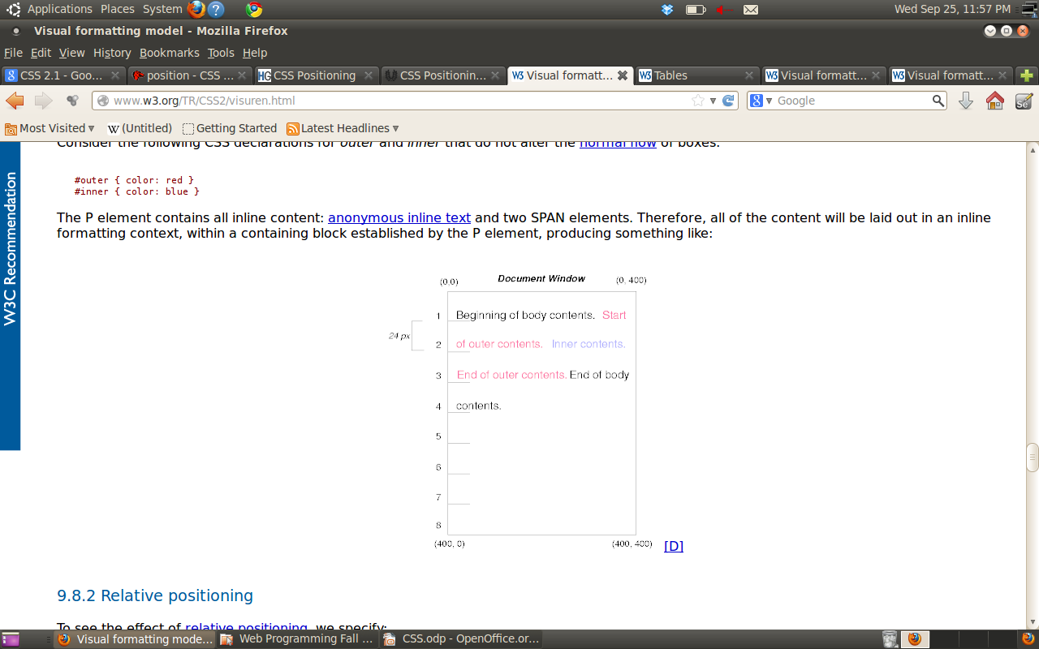
Static Positioning Example
<HTML>
<HEAD>
<TITLE>Comparison of positioning
schemes</TITLE>
</HEAD>
<BODY>
<P>Beginning of body contents.
<SPAN id="outer"> Start of outer contents.
<SPAN id="inner"> Inner contents.</SPAN>
End of outer contents.</SPAN>
End of body contents.
</P>
</BODY>
</HTML>
#outer { color: red }
#inner { color: blue }
body { display: block; font-size:12px;
line-height: 200%; width: 400px; height: 400px }
p { display: block }
span { display: inline }

Slide 17
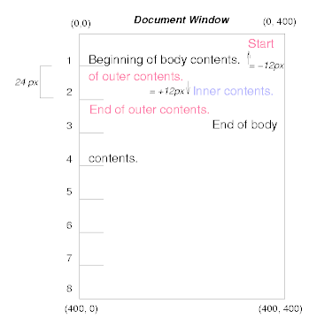
Relative Positioning Example
<HTML>
<HEAD>
<TITLE>Comparison of positioning
schemes</TITLE>
</HEAD>
<BODY>
<P>Beginning of body contents.
<SPAN id="outer"> Start of outer contents.
<SPAN id="inner"> Inner contents.</SPAN>
End of outer contents.</SPAN>
End of body contents.
</P>
</BODY>
</HTML>
#outer { position: relative; top: -12px; color: red }
#inner { position: relative; top: 12px; color: blue }
body { display: block; font-size:12px;
line-height: 200%; width: 400px; height: 400px }
p { display: block }
span { display: inline }

Slide 18
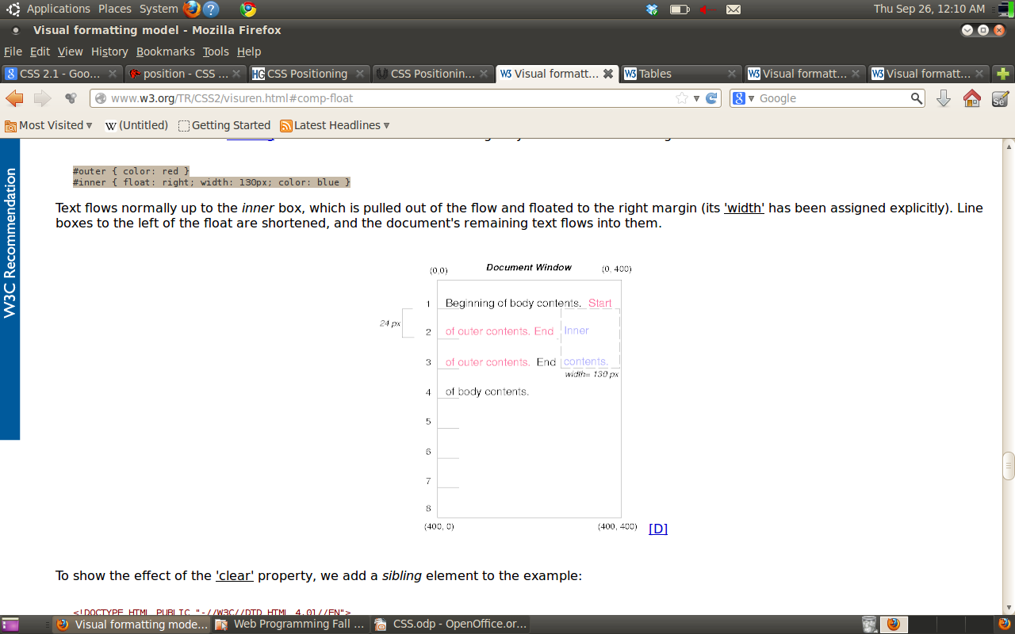
Floating Example
<HTML>
<HEAD>
<TITLE>Comparison of positioning
schemes</TITLE>
</HEAD>
<BODY>
<P>Beginning of body contents.
<SPAN id="outer"> Start of outer contents.
<SPAN id="inner"> Inner contents.</SPAN>
End of outer contents.</SPAN>
End of body contents.
</P>
</BODY>
</HTML>
#outer { color: red }
#inner { float: right; width: 130px; color: blue }
body { display: block; font-size:12px;
line-height: 200%; width: 400px; height: 400px }
p { display: block }
span { display: inline }

Slide 19
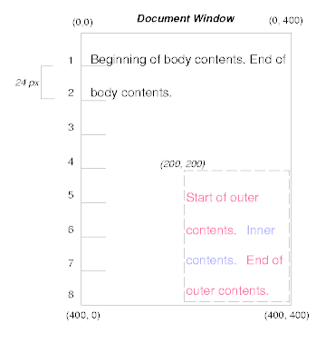
Absolute Positioning Example
<HTML>
<HEAD>
<TITLE>Comparison of positioning
schemes</TITLE>
</HEAD>
<BODY>
<P>Beginning of body contents.
<SPAN id="outer"> Start of outer contents.
<SPAN id="inner"> Inner contents.</SPAN>
End of outer contents.</SPAN>
End of body contents.
</P>
</BODY>
</HTML>
#outer { position: absolute; top: 200px; left: 200px; width: 200px; color: red; }
#inner { color: blue }
body { display: block; font-size:12px;
line-height: 200%; width: 400px; height: 400px }
p { display: block }
span { display: inline }

